Slide 1
Organizational Update
July 20, 2022
Kane County Board- Public Health Committee
Michael Isaacson, MPH
Executive Director
Kane County Health Department

Slide 3
Initial 30 Day Focus- Employees
Surveyed staff for perceived strengths and opportunity areas
Conducting 1:1 input sessions with full time, seasonal and temporary employees
Evaluated past four years of exit interviews & four years of staff meeting evaluations
Next Steps
Form cross-program teams to address opportunities
Create resident input opportunities
Develop new collaborative efforts with businesses and organizations
Launch community behavioral health intervention

Slide 4
Current Public Health Issues
Monkeypox
Currently, two cases in Kane County (200 in Illinois)
Working with providers on education and vaccine distribution
Gun Violence- Reimagine Public Safety Act
Working with Aurora Stakeholders over past several months
Illinois Department of Human Services releasing funding to support local efforts

Slide 5
COVID-19 Update
July 20, 2022
Kane County Board- Public Health Committee
Michael Isaacson, MPH
Executive Director
Kane County Health Department

Slide 6
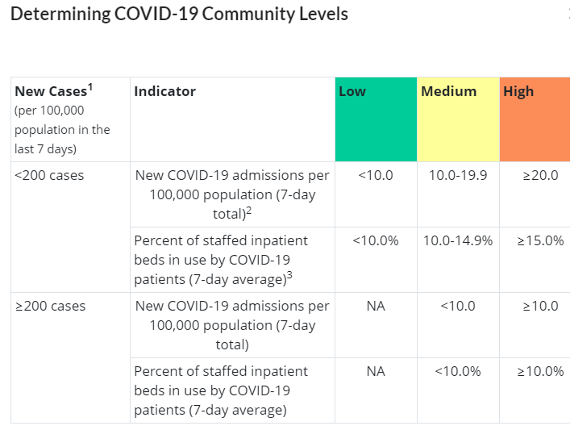
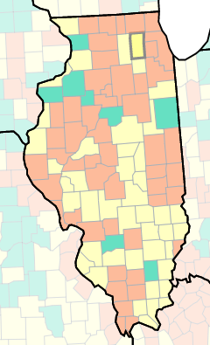
COVID-19 Community Level Updated Every Thursday
6.4
3.7%
237.79
Source: CDC
Updated 7/14/2022

Slide 7
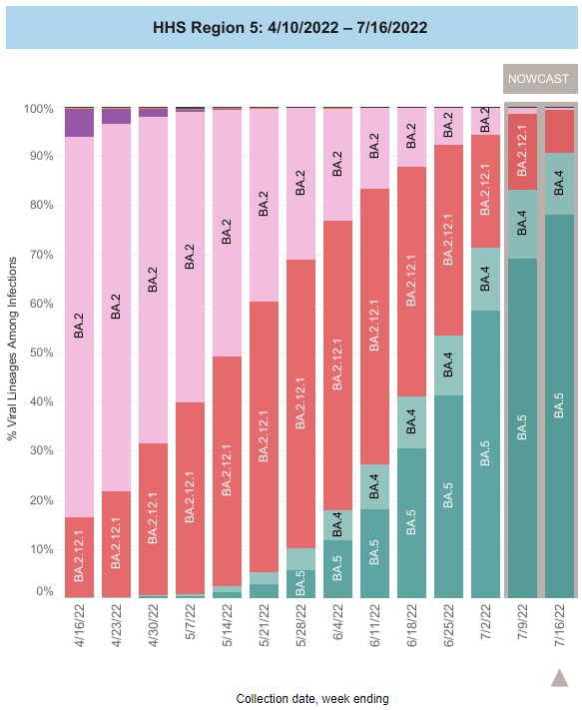
Variants in HHS Region 5
BA.4 and BA.5 are now @ 90% of cases in our region
BA.5 is causing more reinfection in people who have had COVID, including Omicron
BA.5 infecting more fully vaccinated people (Vaccine still reduces severity & Death)
These variants do not appear to cause more sever illness
Source: CDC
Updated 7/19/2022

Slide 8
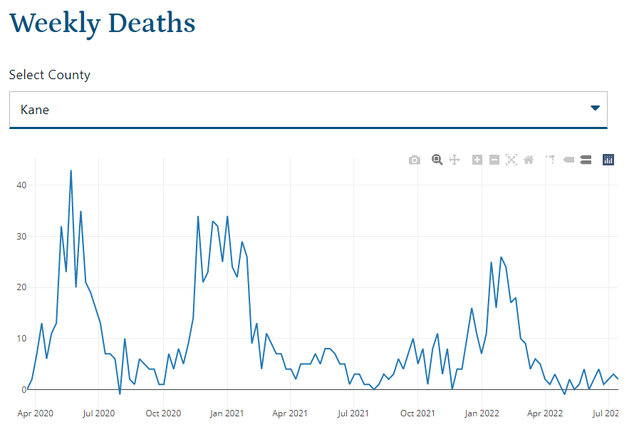
Source: Illinois Department of Public Health
Updated 7/19/2022

Slide 9
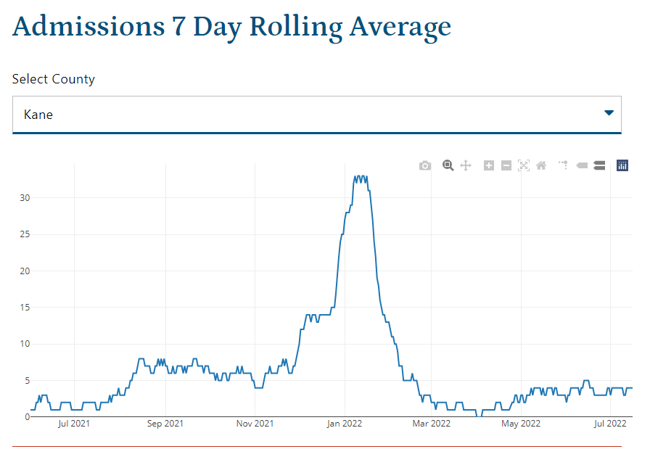
Source: Illinois Department of Public Health
Updated 7/19/2022

Slide 10
Get Vaccinated & Boosted Use Caution & Get Tested After Exposure Stay Home When Sick Thank you

