Slide 1
Monkeypox (MPV) Situational Update
Apryll Elliott, M. Ed., BSN RN, PEL-SN
Assistant Director for Communicable Disease
07/25/2022

Slide 2
MPV Current Data Trends
Data as of 07/25/2022
Data Source: https://www.cdc.gov/poxvirus/monkeypox/response/2022/us-map.html
Geographical Location | # of Cases
Globally | 18,095
United States | 3,487
Illinois | 344
Kane County | 4

Slide 3
Monkeypox (MPV)
Mode of Transmission
close personal contact, including kissing, sex, and other skin-to-skin or face-to-face contact.
Incubation Period
ranges from 5-21 days with an average incubation of 7-14 days
Infectious Period
begins at the onset of symptoms and ends once all lesions have crusted over, fallen off and new healthy skin is visible
Illness Duration
typically 2 to 4 weeks

Slide 4
MPV Signs and Symptoms *The patient may or may not experience prodrome prior to rash*
Fever or Chills
Headache
Muscle Ache or backache
Swollen Lymph Nodes
Exhaustion
Rash, Bumps or Blisters
May appear anywhere on the body, including genitals. May look similar to syphilis, herpes, or other common skin rashes
May present as co-infection sexually transmitted infections (STIs)

Slide 5
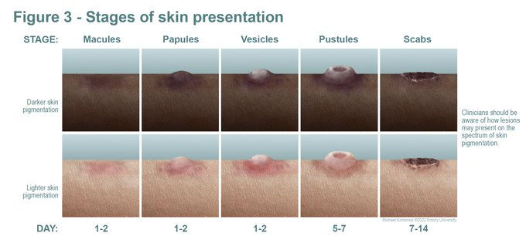
Monkeypox (MPV)
Patient History and Presentation
Determine if, within 21 days of illness onset the individual has:
Had contact, including sexual, with anyone with a rash or confirmed/probable monkeypox
Traveled outside the US or to a state with monkeypox cases
Had contact with a dead or live wild animal or exotic pet endemic to Africa
Examine patient for deep-seated and well-circumscribed lesions, often with central umbilication
Obtain swabs
May rapidly progress through stages
Any person, regardless of gender identity or sexual orientation, can acquire and spread monkeypox

Slide 6
Testing for MPV
Commercial laboratories
Labcorp
Mayo Clinic
Quest Diagnostics
Aegis Laboratories
IDPH Laboratories
CDC Confirmatory Testing

Slide 7
MPV Vaccine Update
KCHD received first shipment of Jynneos vaccine July 15th
KCHD began redistribution:
Open Door
VNA Health Care

Slide 8
MPV Prioritization of Jynneos Vaccine
PEP++ (Expanded Post-Exposure Prophylaxis)
gay, bisexual, and other MSM (cisgender or transgender) ages 18 and older and who have had multiple or anonymous sex partners or engaged in high-risk sexual activities in the past 14 days
PEP (Post –Exposure Prophylaxis)
Named contacts of identified cases in occupational and community settings
PreP (Preexposure Prophylaxis)
People at occupation risk according to ACIP guidance which includes lab works, selected clinicians, and response team members

Slide 9
MPV Reducing Stigma
Describe monkeypox as a legitimate public health issues that is relevant to all people
Educate about monkeypox
How is it spread
Encourage seek health care if experiencing monkeypox-like symptoms
Frame the image of monkeypox by
Using inclusive language
Using language that resonates with the audience
Emphasizing prevention strategies, symptom recognition, and the treatable nature of monkeypox to minimize fear and promote action and sense of personal agency

